Slide 1

Would you chose to subscribe Netflix or Disney plus?
A comparative study

Slide 2
Contents
Background
Research Question
Comparison of the contents
Disney’s Growth strategy based on it’s competitive edge
Further discussions

Slide 3
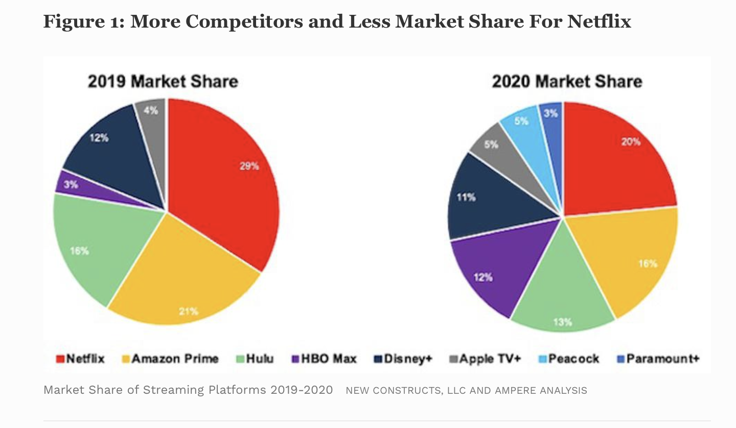
Background What movies would you enjoy seeing without going into a movie theatre? And how does Disney Plus do in these genres?
Disney entered the streaming market in October 2019.
With a vast number of original productions, Can Disney Plus’ content compete with NetFlix?
Picture comes from Forbes.com, May 10, 2021,09: Netflix: a Meme – Stock Original by David Trainer of Great Spectation Groups

Slide 4
Research Question
How do Disney Plus movies perform in terms of ratings as compared with Netflix’ movies of the same genres?
How should Disney Plus’ form its strategy going forward to maintain it’s competitive edge?

Slide 5
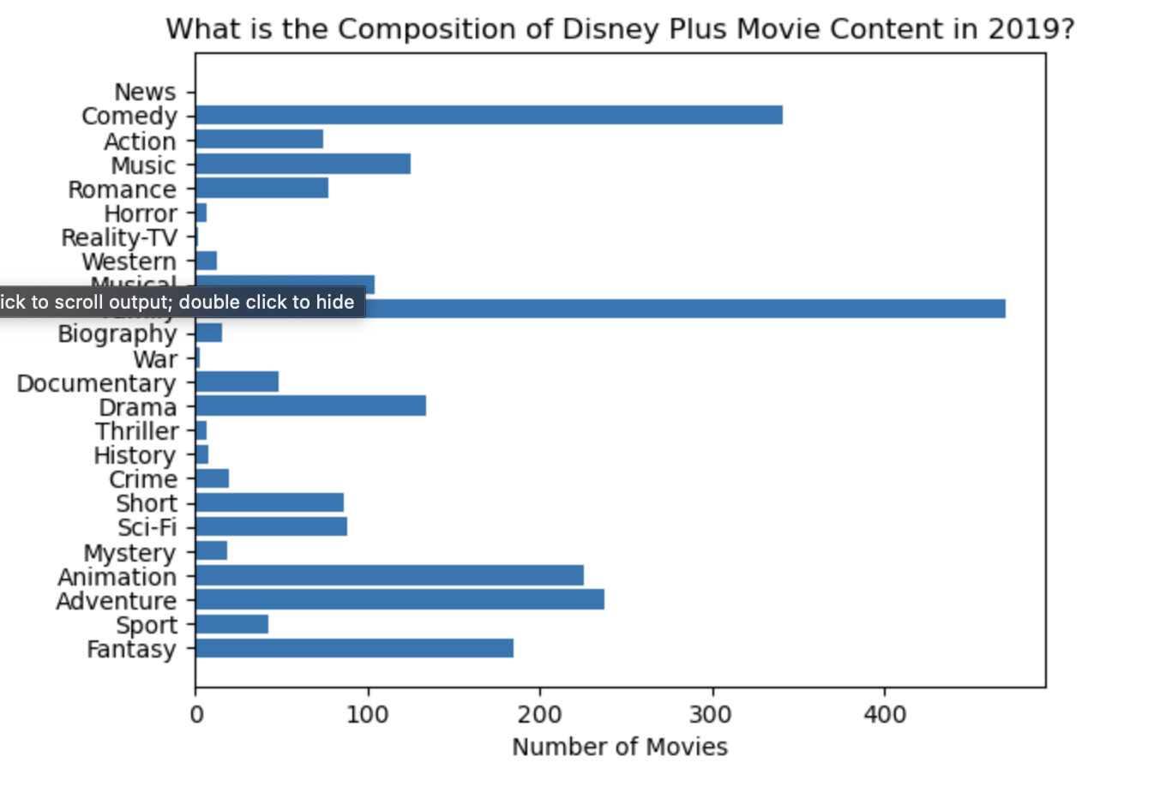

Slide 6
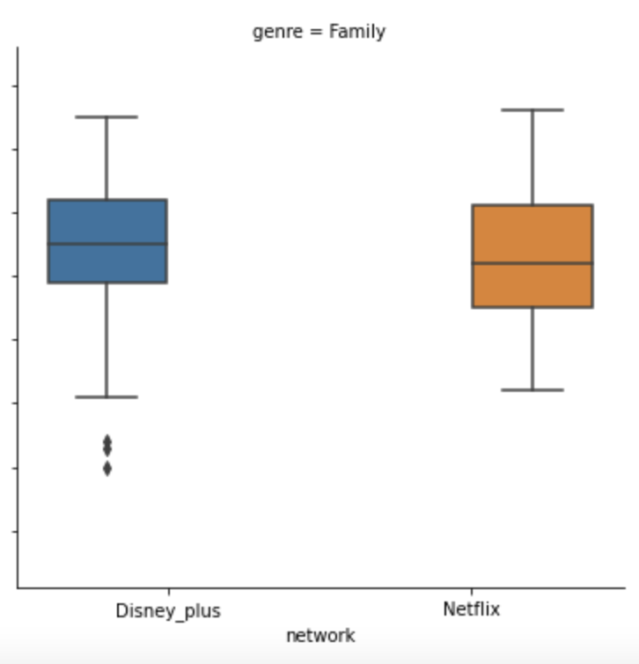
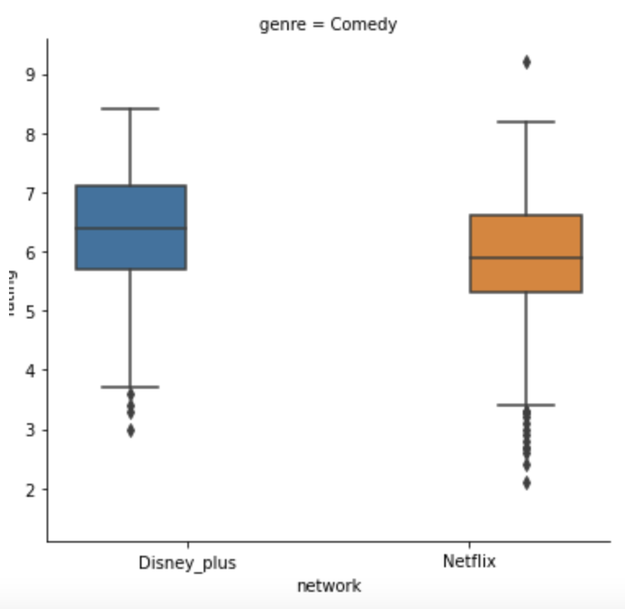
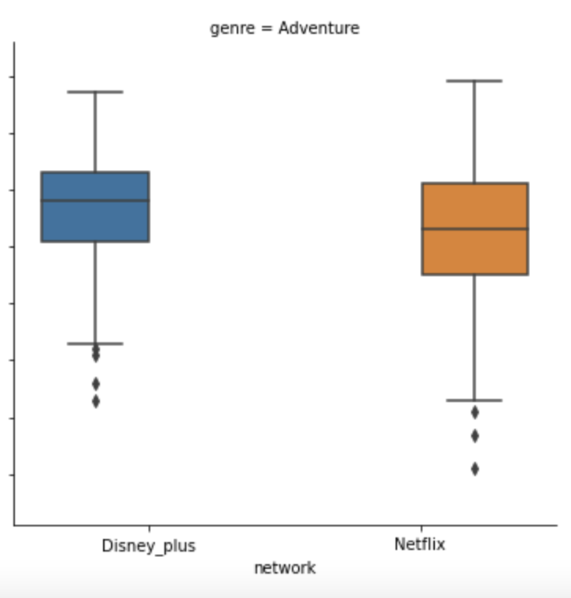
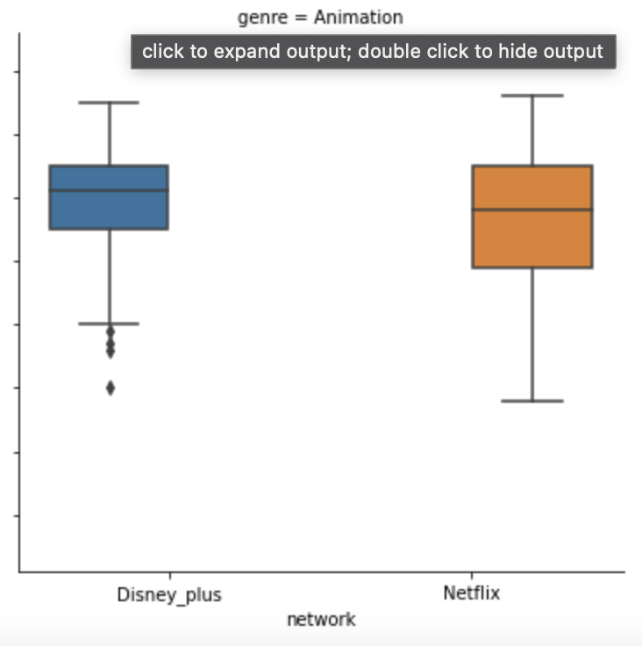
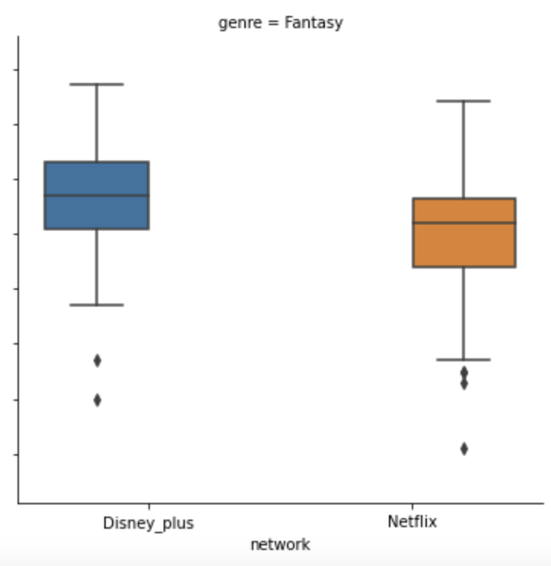
Families, Comedies, Adventures, Animations and Fantasies

Slide 7
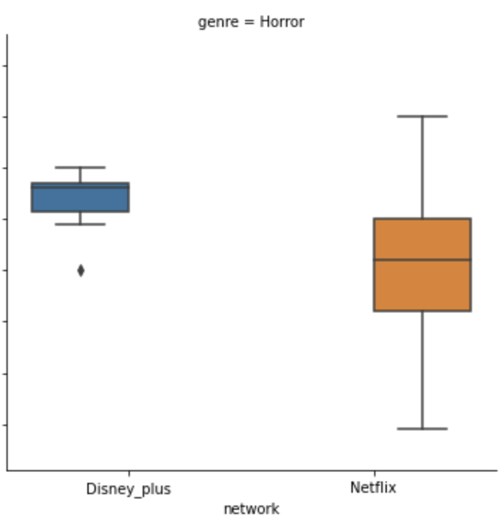
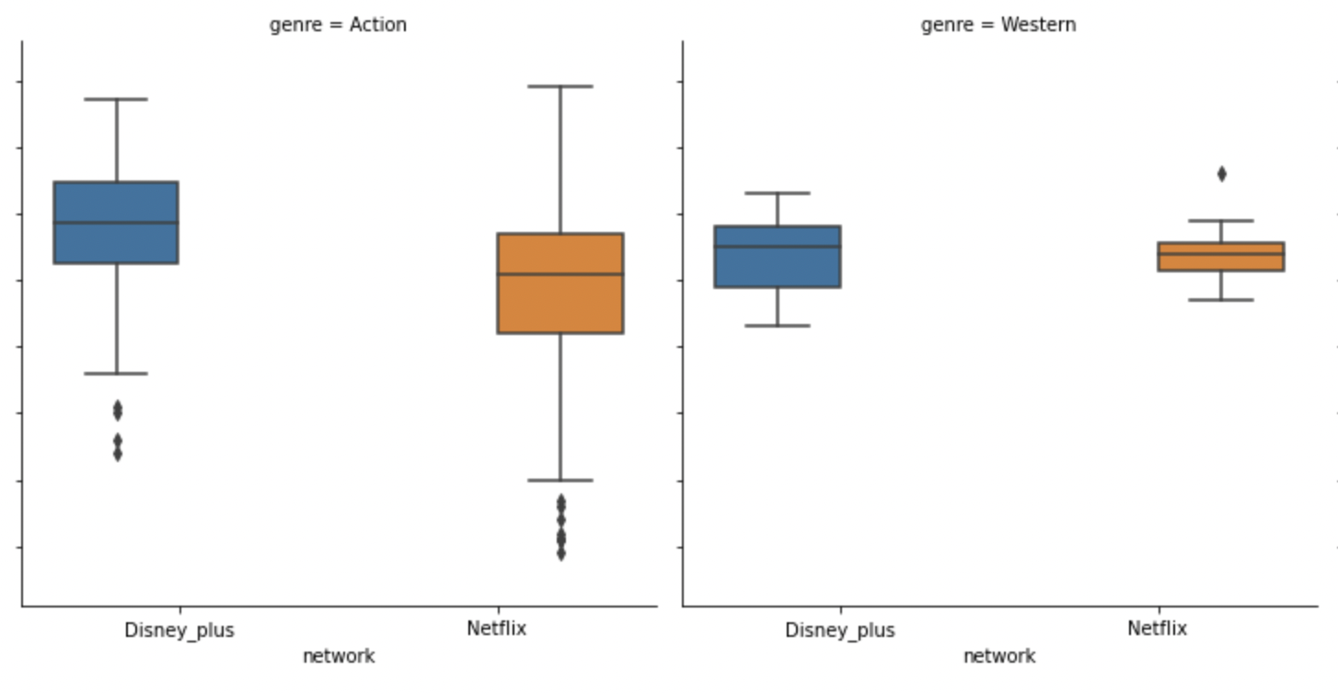
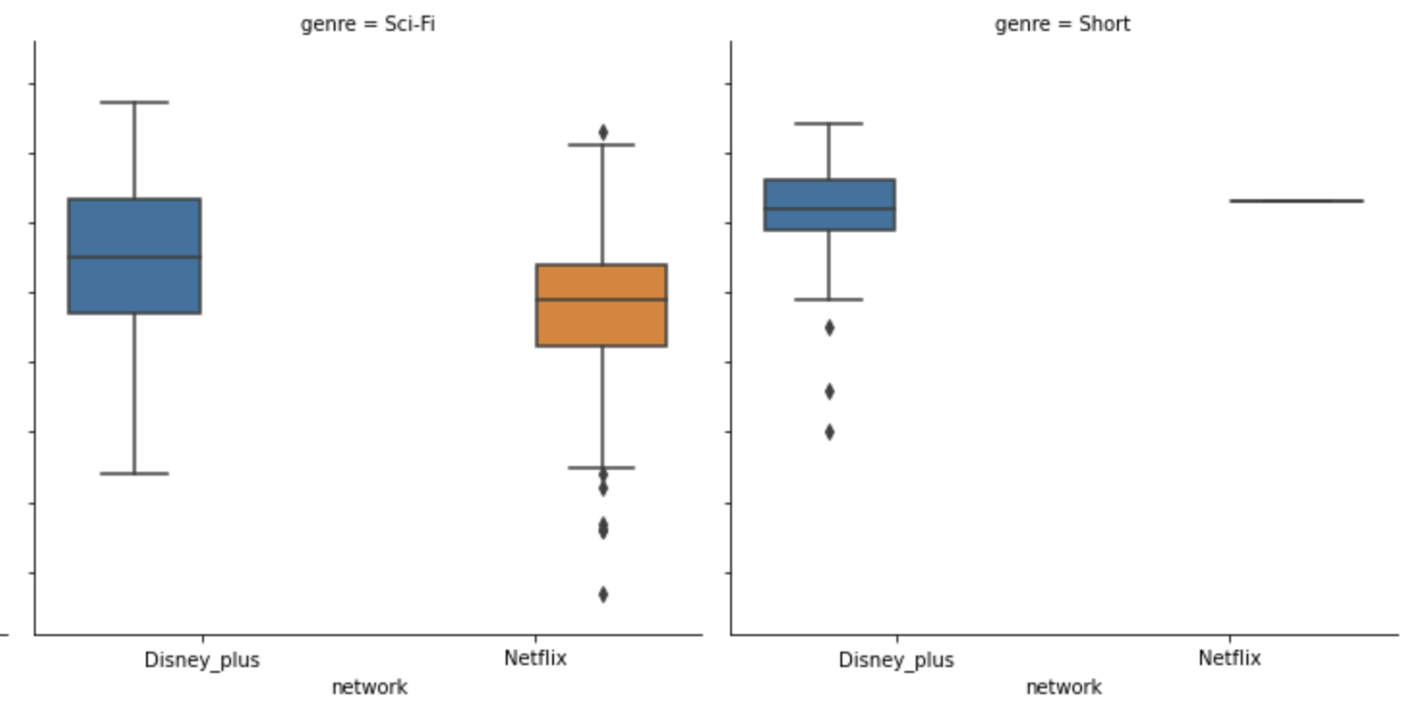
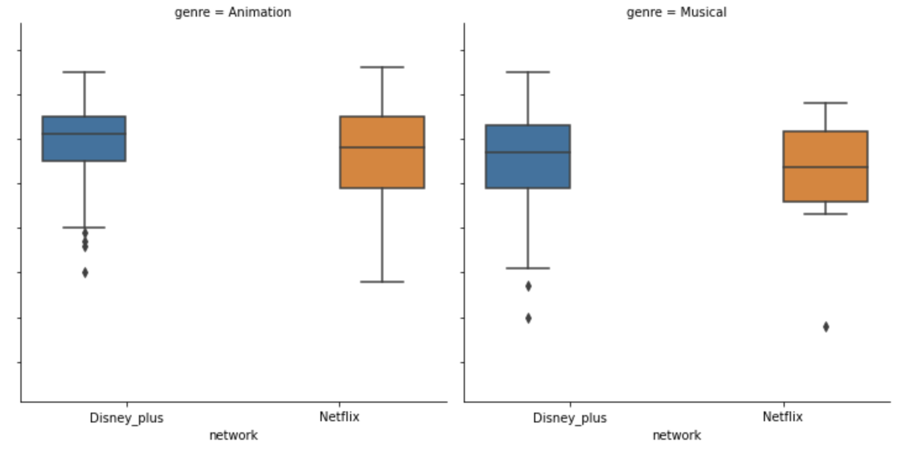
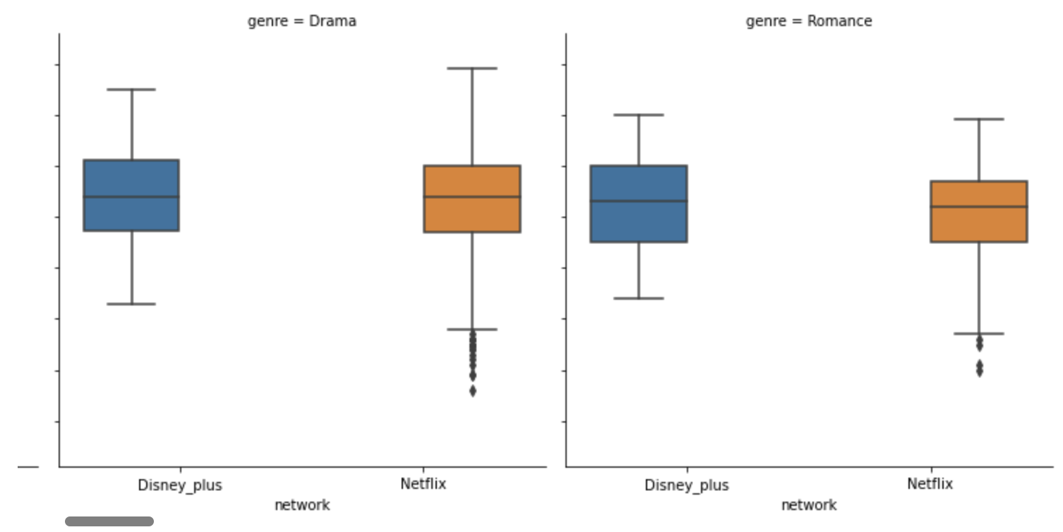
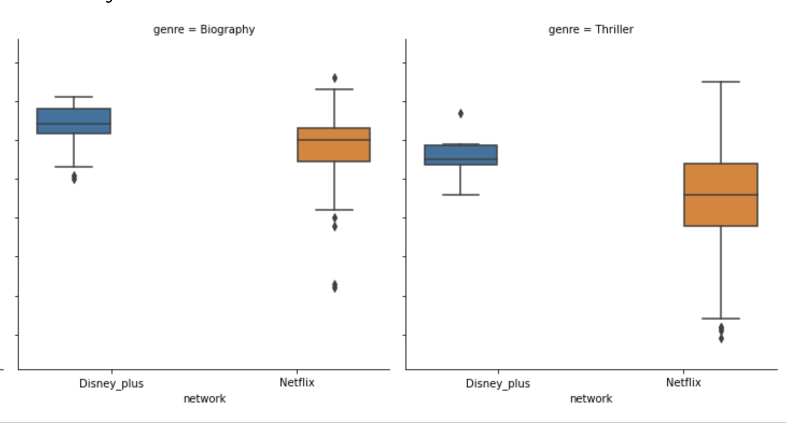
What about other genres?

Slide 8
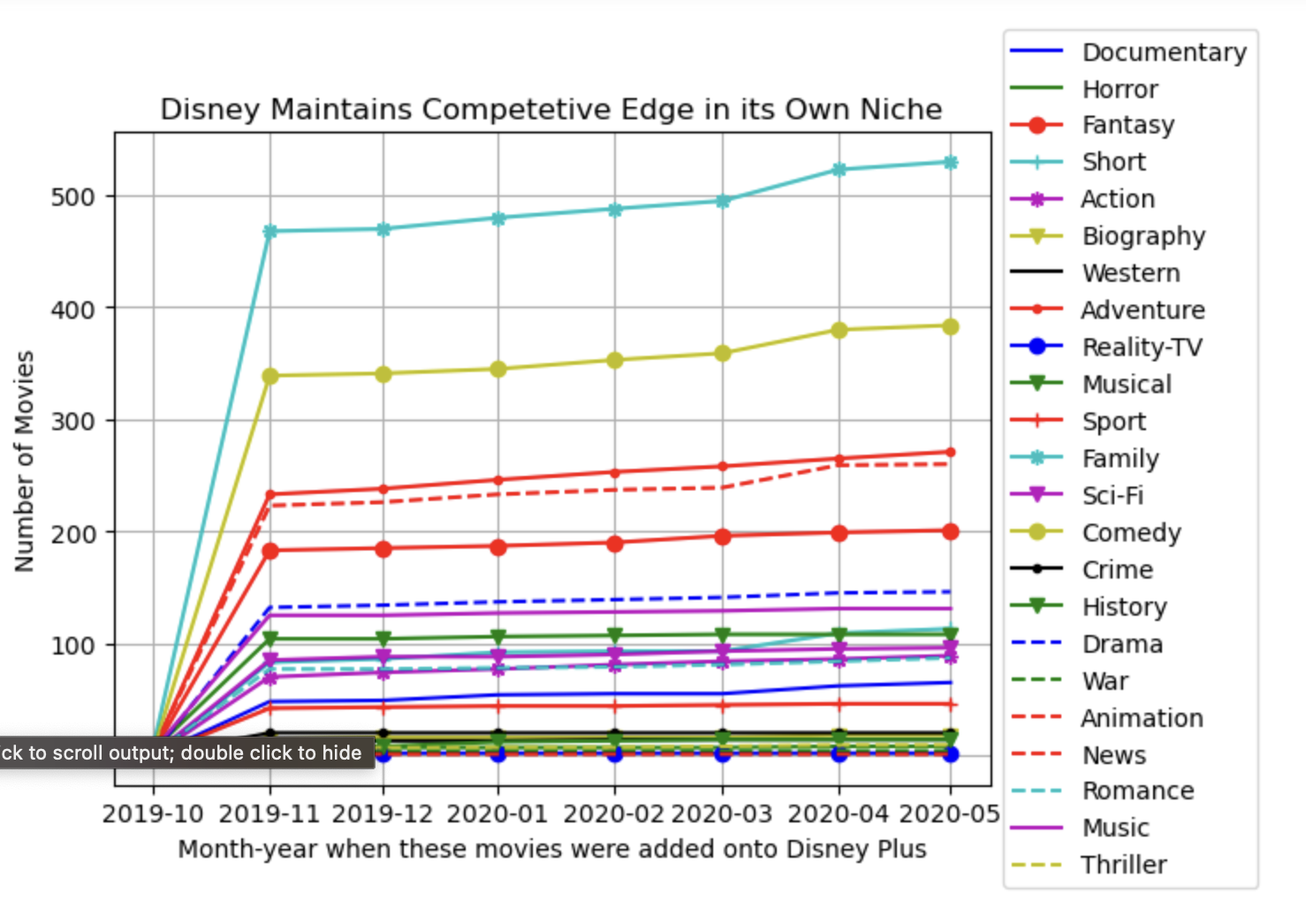
How did Disney Plus grow its movie contents since its launch?

Slide 9
Net Steps
Integrate other measurements of evaluating the health of the network:
Average length of TV series?
Growth of Subscription numbers
length of TV runtime analysis of the two networks.
A deeper dive into products subtypes:
Movies → TV movies
TV shows → mini series

Slide 10
Appendix
Kaggle Datasets:
Disney Plus Movie and TV shows by Raphael Fontes
Netflix Movie and TV shows by Snehaan Bhawal

